Slide 1
July 24, 2023
Predicting
Academic Performance
Models, Predictions, and Business Applications
Group 1:
STA380 - Introduction to Machine Learning

Slide 2
Group 1
Luis Villazon | lrv499
Pritesh Singh | ps35762
Mandeep S Burdak | msb4384
Teagan Milford | tm38292
Sardar Muhammad Ahmad Ali | sa58382
John Hwang | jh75576

Slide 3
Overview
Problem Statement & Data
The Modeling Process
Results & Conclusions

Slide 4

The Problem & the Data

Slide 5
Unraveling the influence: Predicting Academic Performance
We aim to predict high school students academic performance based on their social, demographic and behavioral characteristics.

Slide 6
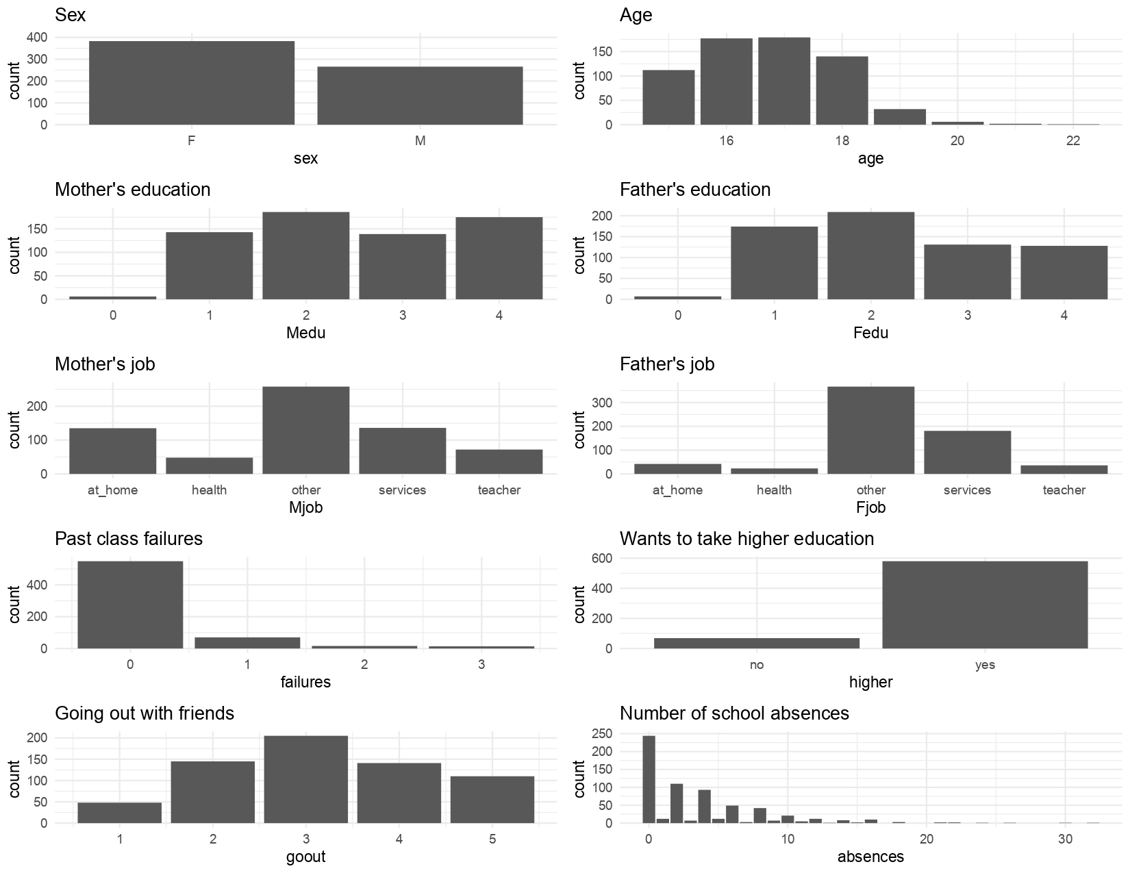
Outline of the Data
Some predictors:
Originates from a survey of students math and portuguese language courses in secondary school in Portugal.
Total: 649 students, 31 variables.
No presence of missing values.
Variable of interest: Overall Grade (from 0 to 20).
Notes:
notes

Slide 7

Process & Methodology

Slide 8
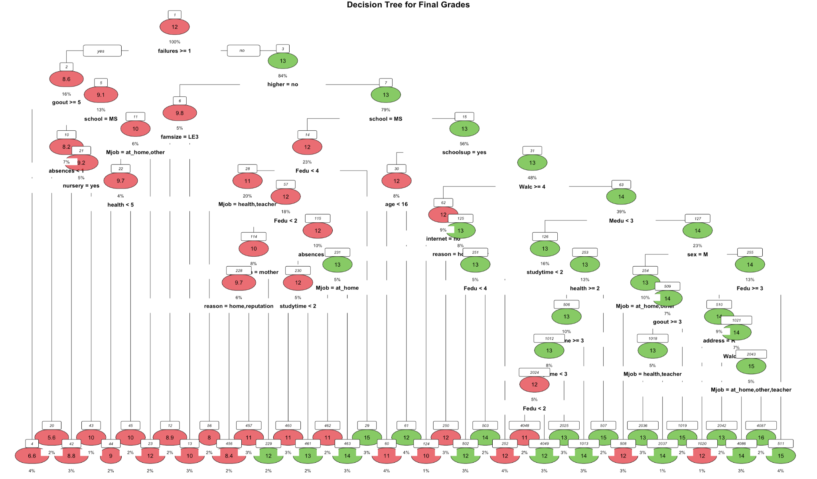
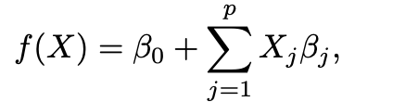
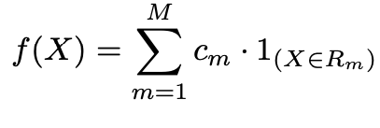
Trees > Regression
Algorithm | MSE
Tree | 12.27
Regression:
Trees:
Notes:
Trees can easily handle qualitative predictors without the need to create dummy variables.
trees can be very non-robust. In other words, a small change in the data can cause a large change in the final estimated tree.

Slide 9
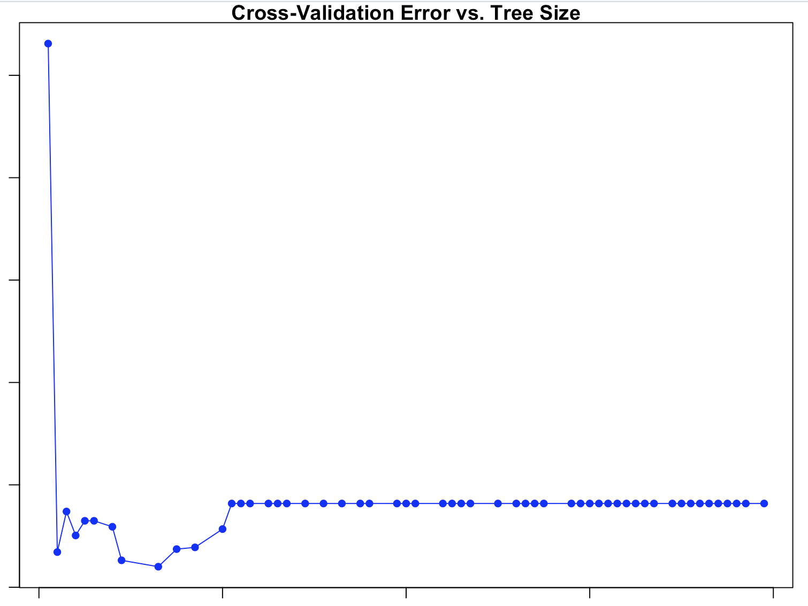
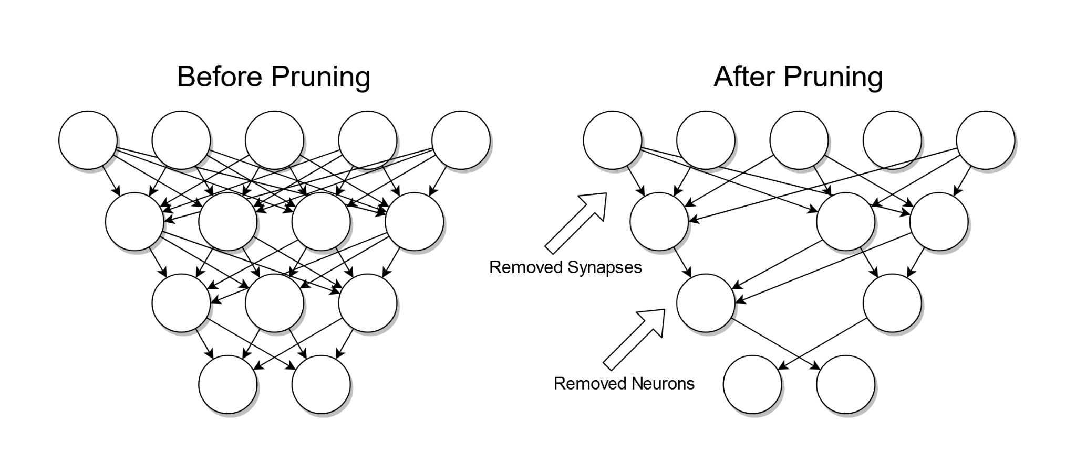
Gardening 101: Pruning
Algorithm | MSE
Tree | 12.27
After Pruning | 10.61
Cross validation error
Tree Size
Notes:
The process described in the previous slide may produce good predictions on the training set, but is likely to overfit the data, leading to poor test set performance.
This is because the resulting tree might be too complex.
A smaller tree with fewer splits might lead to lower variance and better interpretation at the cost of a little bias

Slide 10
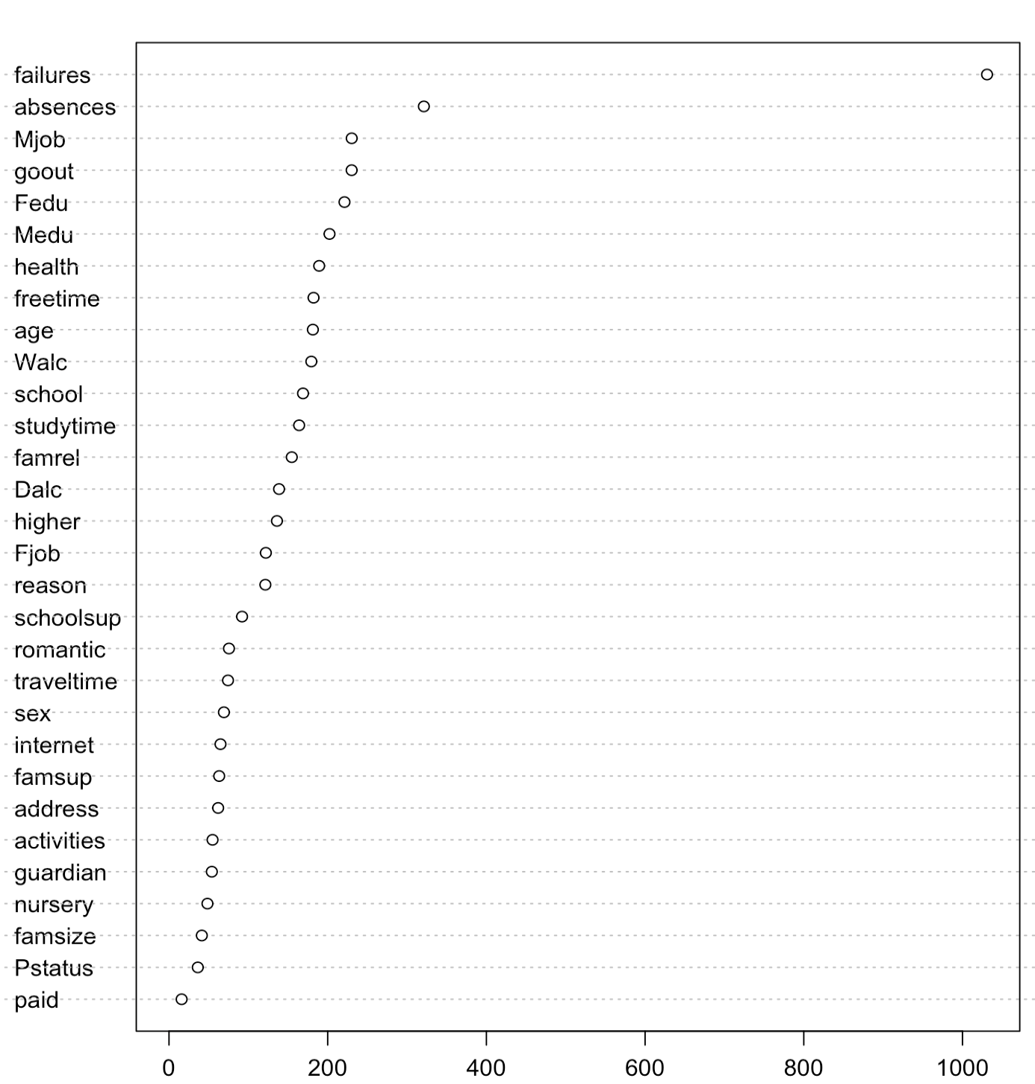
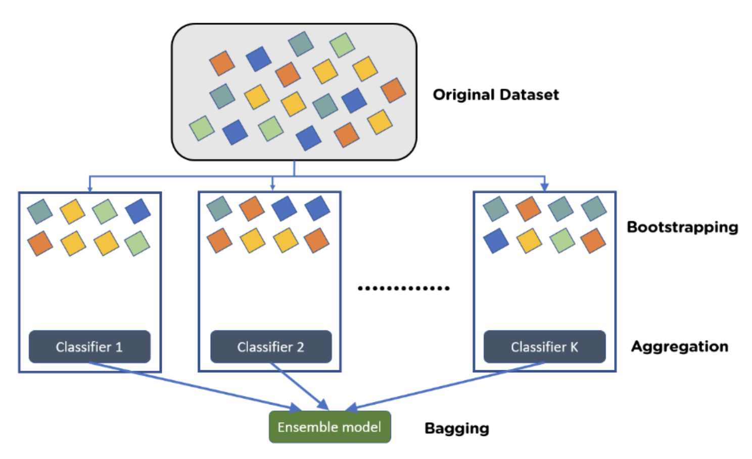
Bagging
Variable Importance
Algorithm | MSE
Tree | 12.27
After Pruning | 10.61
Bagging | 8.29
Variables
Node Purity
Notes:
The decision trees tested so far suffer from high variance.
This means that when we split the training data into two parts at random, and fit a decision tree to both halves, the results that we get were quite different.
Bootstrap aggregation, or bagging, is a general-purpose procedure for reducing the variance of a statistical learning method
we simply construct B regression trees using B bootstrapped training sets, and average the resulting predictions.
These trees are grown deep, and are not pruned.
Hence each individual tree has high variance, but low bias. Averaging these B trees reduces the variance

Slide 11


Random Forest

Slide 12
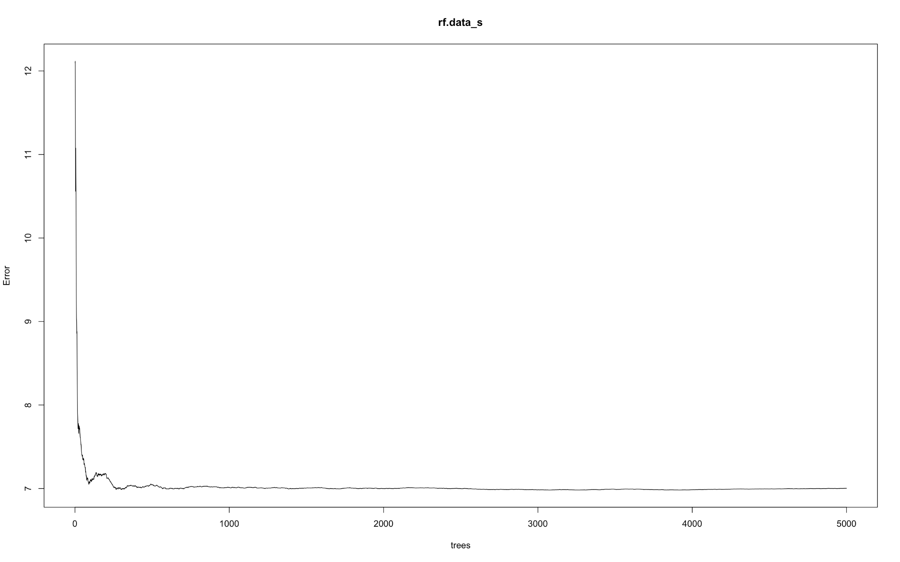
Random Forest
Algorithm | MSE
Tree | 12.27
After Pruning | 10.61
Bagging | 8.29
Random Forest | 7.86

Slide 13
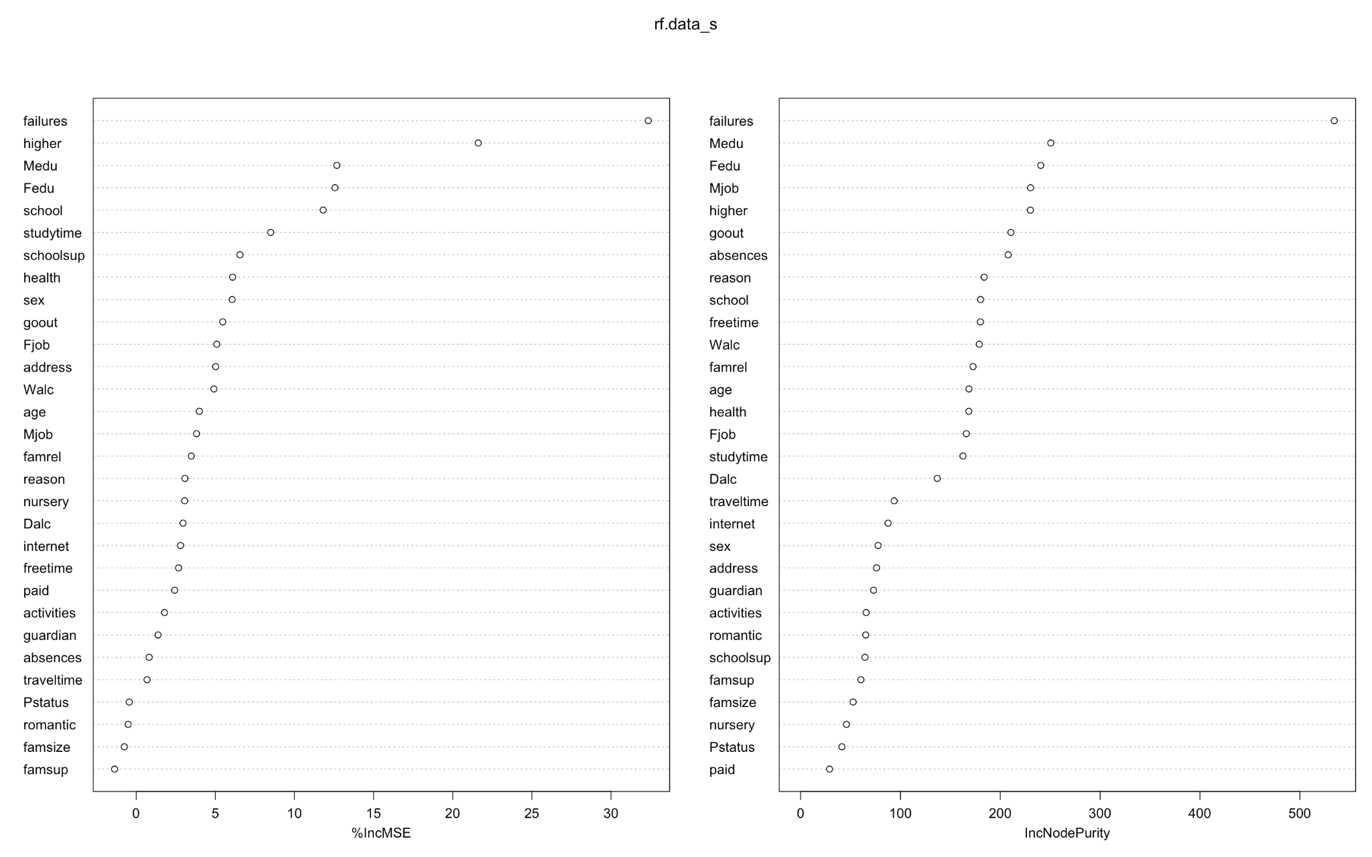
Random Forest

Slide 14
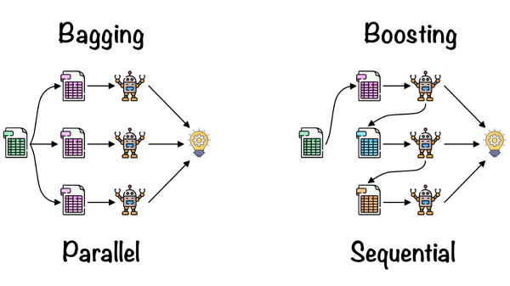

Boosting

Slide 15
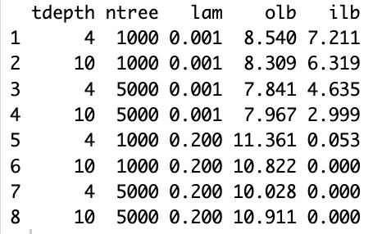
Boosting
Algorithm | MSE
Tree | 12.27
After Pruning | 10.61
Bagging | 8.29
Random Forest | 7.86
Boosting | 7.84

Slide 16
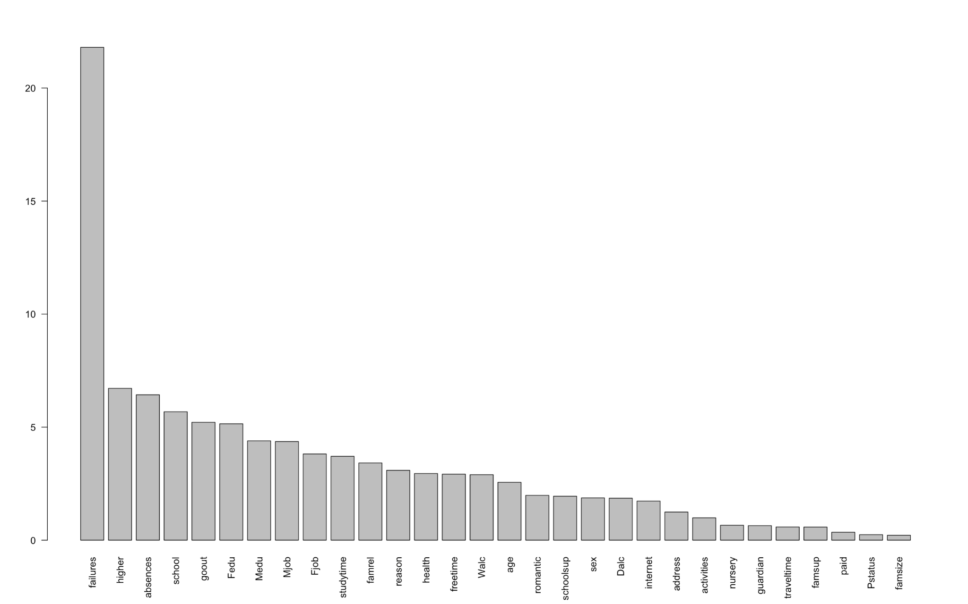
Boosting

Slide 17
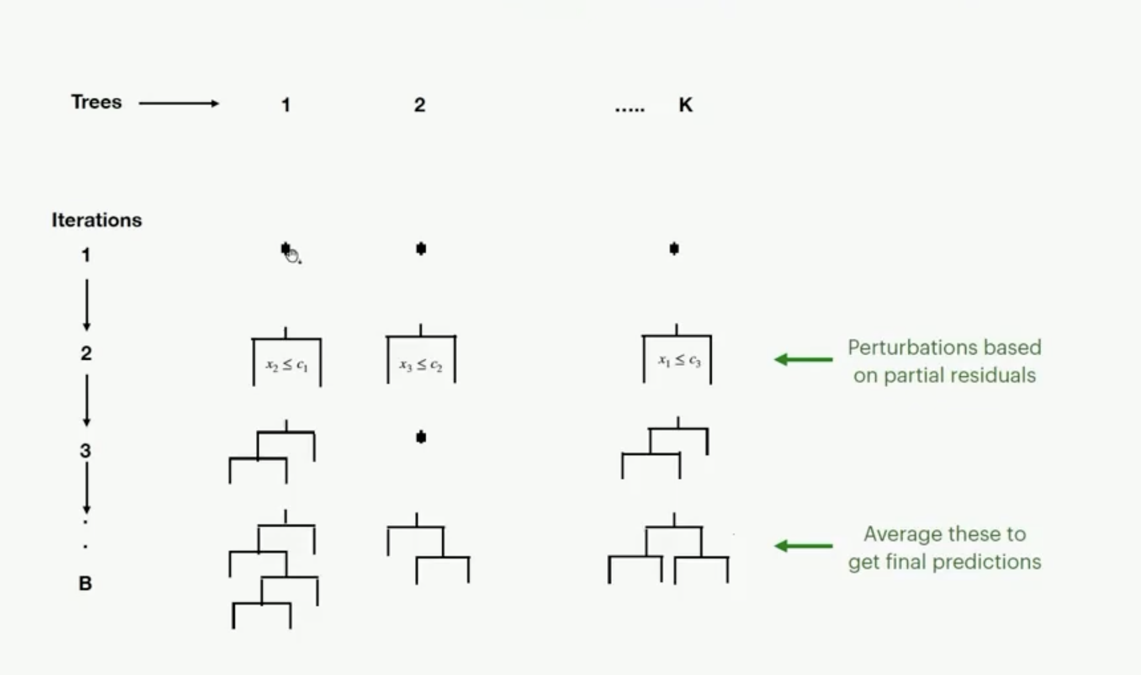

BART(Bayesian Additive Regression Trees)
Notes:
Just like Bart simpson, this was not in class

Slide 18
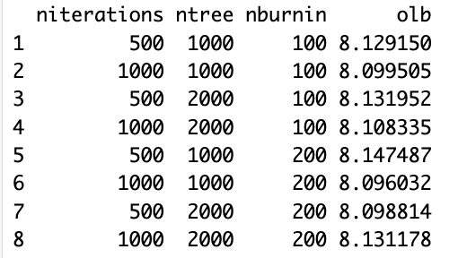
BART(Bayesian Additive Regression Trees)
Algorithm | MSE
Tree | 12.27
After Pruning | 10.61
Bagging | 8.29
Random Forest | 7.86
Boosting | 7.84
BART | 8.09
Notes:
Just like Bart simpson, this was not in class

Slide 19
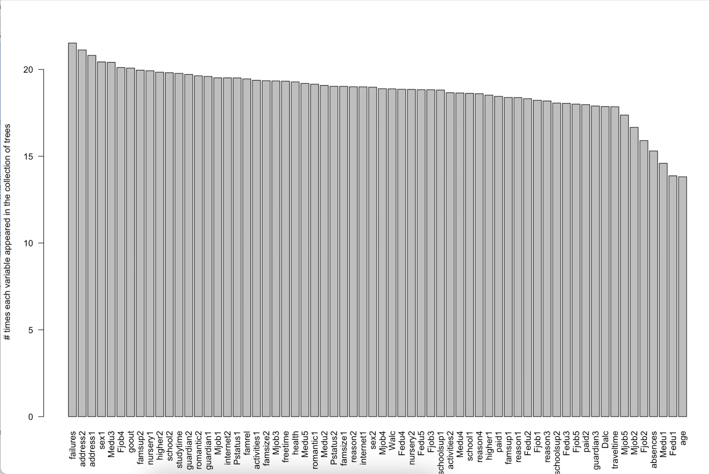
BART

Slide 20
Minimizing Error
Model | MSE
Tree | 12.26926
Pruning | 10.60838
Bagging | 8.293745
R.F. | 7.864276
Boosting | 7.841
BART | 8.096032
Boosting
BART

Slide 21
Destined to Fail?
Random Forest
Bagging
> importance(rf.data_s)
%IncMSE IncNodePurity
school 7.87236368 177.67317
sex 4.15157182 84.72829
age 3.31704328 162.25867
address 3.93901150 76.18431
famsize -0.27372196 50.56302
Pstatus 2.22903712 47.22555
Medu 10.31763237 249.41070
Fedu 7.67767530 235.20891
Mjob 2.69822739 231.82070
Fjob 3.60368232 167.77553
reason 1.61683968 195.18425
guardian 0.66362028 74.14570
traveltime -1.16723421 87.56314
studytime 7.20414450 167.49438
failures 23.45951343 533.77967
schoolsup 5.91085597 65.41860
famsup -1.64554109 60.72090
paid 0.90949890 29.50861
activities 4.14095148 66.73110
nursery 1.97687039 47.22983
higher 13.54650867 212.23029
internet 3.23025726 83.95035
romantic -0.21261869 70.12948
famrel -0.09498381 156.68320
freetime 3.47810110 183.82659
goout 2.67437908 208.30125
Dalc 0.94545908 137.73896
Walc 3.80621632 177.78804
health 2.03990591 167.34255
absences 3.55376171 212.99961
> importance(bag.data_s)
%IncMSE IncNodePurity
school 9.01740178 157.84985
sex 3.35823224 69.31898
age 3.77131560 169.13127
address 2.39811576 56.57384
famsize 0.16032176 36.27757
Pstatus -0.09693026 30.16329
Medu 8.93553736 230.85451
Fedu 10.96130537 253.37108
Mjob 5.78383714 281.97279
Fjob 7.14710752 173.76048
reason 3.08188091 197.73845
guardian -1.09959138 56.94269
traveltime -0.11889317 64.94913
studytime 5.92189317 150.18334
failures 32.71783202 1022.41379
schoolsup 7.68675397 85.71313
famsup 0.80816358 57.36454
paid -0.59200995 16.22530
activities -1.26951988 55.80437
nursery 2.38710335 39.29559
higher 15.55814394 131.84226
internet -1.38793344 64.10842
romantic 1.29851425 70.72750
famrel 0.26497954 142.24913
freetime -1.32690204 165.98277
goout 4.16456294 212.36576
Dalc -2.33675069 130.24237
Walc 0.89192154 156.66969
health 6.43471017 169.63197
absences 5.06168352 282.36994

Slide 22
Business Applications
Universities and Admissions Officers
Program Performance Our model can be used by universities to predict applicants expected performance in their programs and make admissions decisions based on that information.
Scholarships: It will also be able to assist admission officers with distribution of merit based scholarships and aid based on not just current but future grade predictions
Current Students: The university will be able to adjust their academic policies in a way that supports students who are predicted to struggle with academics. Professors will be able to provide extra support in courses where mean predicted grade is low.
Ranking and Reputation:The model aims to create a positive impact on performance of students, students graduating and overall ranking and reputation of the institution

Slide 23
Business Applications
Banks and Student Loan Institutions
Risk Assessment for Student Loans: Can be used to assess the risk associated with lending money to individual students
Default Risk Assessment: Banks and loan institutions can use the predictive model to assess the risk of default on existing student loans
Personalized Loan Offers: Banks and student loan providers can use the predictive model to offer personalized loan terms based on a student's predicted academic performance
Risk Diversification and Portfolio Management: For banks that have a portfolio of student loans, the model will help diversify the loan distribution based on predicted academic performance

Slide 24
Limitations
Sample Bias: The data used to train our model is not representative of the entire student population. The data comes from Portugal and the predictions might not generalize well to other populations
Data Reliability: We are relying on the fact that students are honest when asked about their frequency of alcohol consumption which wasn't a factor, when in reality that could very well not be case
Changing Behavior: Student behavior, can change over time. If the data used to train the model becomes outdated, the model's predictions may no longer align with current patterns

Slide 25

THANK
YOU

Slide 26
Points
Better slides on Trees and initial algos
Slide counter, location in presentation
Catchy Intro (Question) → How we answer the question
Titles giving a takeaway
Consistent story line (Intro → trees, 1 algo → next )
Highlight numbers, don’t give number/text wall
Same units for values
meaning of values
More pictures, less text?
Conclusion, although may not be relevant to us, somethings are very universal. Biases like alcohol or even gender, did not play that important role
Self-fulfilling prophecy?
Good: lot of factors like alcohol doesn’t impact
Bad: no recovery from failures?
Ugly: remove biases and quantify
Appendix:

Slide 27
References:
https://www.kaggle.com/datasets/uciml/student-alcohol-consumption?select=student-por.csv
https://archive.ics.uci.edu/ml/datasets/STUDENT+ALCOHOL+CONSUMPTION
https://icons.iconarchive.com/icons/jonathan-rey/simpsons/256/Bart-Simpson-01-icon.png
https://www.cciconsulting.com/wp-content/uploads/2019/03/Boosting-person-up-over-wall.jpg
https://static2.bigstockphoto.com/4/6/2/large2/264484027.jpg
https://www.statlearning.com/
https://cdn-icons-png.flaticon.com/512/4315/4315881.png
https://av-eks-blogoptimized.s3.amazonaws.com/4661536426211ba43ea612c8e1a6a1ed4550721164.png

Slide 28
APPENDIX

Slide 29
R Snippets
Algorithm | Parameters | Comments
Tree | tree_model <- rpart(G3 ~ ., data = data_train, cp = 0.0001)

